Slide 1
Compulsory Clarification Meeting
RFP NO. :TNPA/2023/09/0002/42116/RFP
TENDER DESCRIPTION: PROVISION OF DESIGN, MANUFACTURE, DELIVERY,
INSTALL, AND COMMISSIONING OF SECURITY FENCING
UPGRADE AT THE PORT OF CAPETOWN FOR A PERIOD OF TWELVE (12) MONTHS
DATE : 16 APRIL 2024
VENUE : Procurement Boardroom
TIME : 11H00

Slide 2
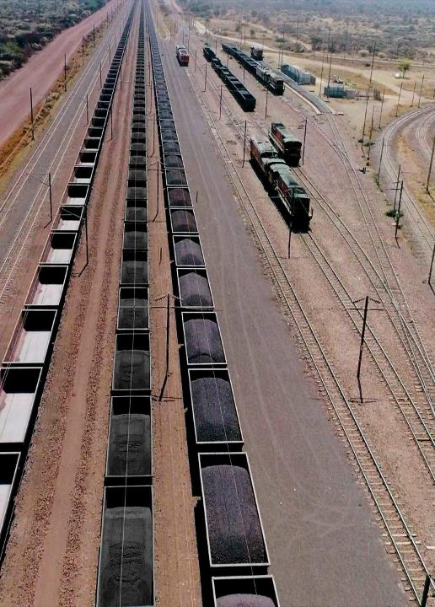
AGENDA ITEM
No. | Agenda Item | Presenter
1 | Welcome / Opening of meeting | Mbaliyamaswazi Maqekeni
2 | Safety Briefing | Leandra Beveridge
3 | Introductions | All Transnet Team
4 | Background and Scope of work | Leandra Beveridge
5 | Tendering Process & Specific Goals | Mbaliyamaswazi Maqekeni & Sala
6. | Technical Evaluation/Functionality | Leandra Beveridge
6.1 | Part T2: Returnable Documents | Mbaliyamaswazi Maqekeni
7. | Part C1: Agreement and Contract Data | Leandra Beveridge
7.1 | C1.1: Contract Data Part 2: Data By the Contractor | Leandra Beveridge
7.2 | C2.2: Bill of Quantities | Sandile Zondi & Leandra Beveridge
8. | Tender Closing | Mbaliyamaswazi Maqekeni
9. | General | Mbaliyamaswazi Maqekeni
10 | Q&A | ALL
2

Slide 3
MEETING RULES
Please put cellphone on mute during the presentations;
Please ensure that you sign the attendance register
No one entity can represent two (2) entities
All questions to be raised after each presentation.
Kindly raise your hand to ask a question
TNPA will endeavor to answer all questions in the session and issue the briefing session minutes.
Questions to be followed-up by email to TNPATenderEnquiriesCPT@transnet.net
Late comers will be allowed; however, nothing will be repeated for their benefit.
Attendees are encouraged to remain for the entire briefing session as important information pertaining to the RFP will be presented.

Slide 4
MEETING PURPOSE AND OBJECTIVE
The purpose of this meeting is to clarify the RFP Tendering procedure, scope of work, deliverables and evaluation criteria
The objective of this meeting is to:
Ensure that there is alignment between Transnet project expectations, RFP Tendering procedure, scope of work, deliverables as well as evaluation criteria.
Ensure bidders submit comprehensive proposals that will allow Transnet to select best value supplier and delivery of the project successfully.
To report any fraud, tip-offs anonymous: 0800 003 056 or transnet@tip-offs.com

Slide 5
RFP INVITATION TO BID
The RFP is available on National Treasury etender portal and Transnet website, free of charge.
This briefing session compulsory, Tenderers will be disqualified for failing to attend the compulsory briefing session.
All the questions and answers will be consolidated and uploaded onto the Transnet e-tender portal and National Treasury e-tender portal.
The closing date for this RFP is the 6 May 2024 @ 16h00 (The tender closes on the Transnet e-Tender Submission Portal: www.transnet.net )

Slide 6
EXECUTIVE SUMMARY & PROJECT BACKGROUND
BACKGROUND
THE END USER TO PROVIDER THE BACKGROUND

Slide 7
Tender Data
Tendering process - Evaluation Methodology​
Step 1: Administrative Responsiveness ​
All returnable documents and schedules received.​​
Step 2: Substantive Responsiveness​
Whether any general pre-qualification criteria set by Transnet, have been met ​
Whether the Bid contains a priced offer
Whether the Bid materially complies with the scope and/or specification given(All Sections)​
Whether any Technical pre-qualification/eligibility criteria set by Transnet have been met (if applicable)
Step 3: Physical Evaluation​ (Minimum Threshold of Technical Evaluation 60%​)
​Step 4: Price/B-BBEE 90/10​
Final weighted evaluation based on 90/10 preference Point​ , Applicable Thresholds and Final Evaluated Weightings
​Step 5: ​Post Tender Negotiations ( if applicable)
​Step 6: Objective Criteria ( if applicable)​
Step 7: Award of Business and Conclusion of Contract

Slide 8
Returnable documents
Procurement Process of Evaluation
2.1.1 These schedules are required for eligibility purposes:
T2.2-01 Stage One as per Compulsory attendance of clarification meeting: Eligibility Criteria Schedule - Certificate of attendance at `Compulsory Tender Clarification Meeting
T2.2-02 Stage Two as per Construction Industry Development Board (CIDB): Eligibility Criteria Schedule – CIDB Registration or Application (8CE or 8SQ or Higher)
2.1.2 Stage Three : These schedules will be utilised for evaluation purposes:
T2.2-03: Evaluation Schedule: Project Organogram, Curriculum Vitaes of Key People,
Qualifications and Employment Letters/Contract
T2.2-04: Evaluation Schedule: Tenderer’s Previous Experience
T2.2-05: Evaluation Schedule: Programme

Slide 9
Returnable documents
T2.2-06: Evaluation Schedule: Health and Safety Requirements
T2.2-06A: Evaluation Schedule: Health and Safety Questionnaire
T2.2-06B: Evaluation Schedule: Health and Safety Cost Breakdown
T2.2-07: Evaluation Schedule: Method Statement
T2.2-08: Evaluation Schedule: Quality Expectations
T2.2-09: Evaluation Schedule: Environnemental Management

Slide 10
Returnable documents
Procurement Process of Evaluation
2.1.4 Stage Four : These schedules will be utilised for claiming points for preference
point system (90/10):

Slide 11
Specific Goals
Supplier Development Team

Slide 12
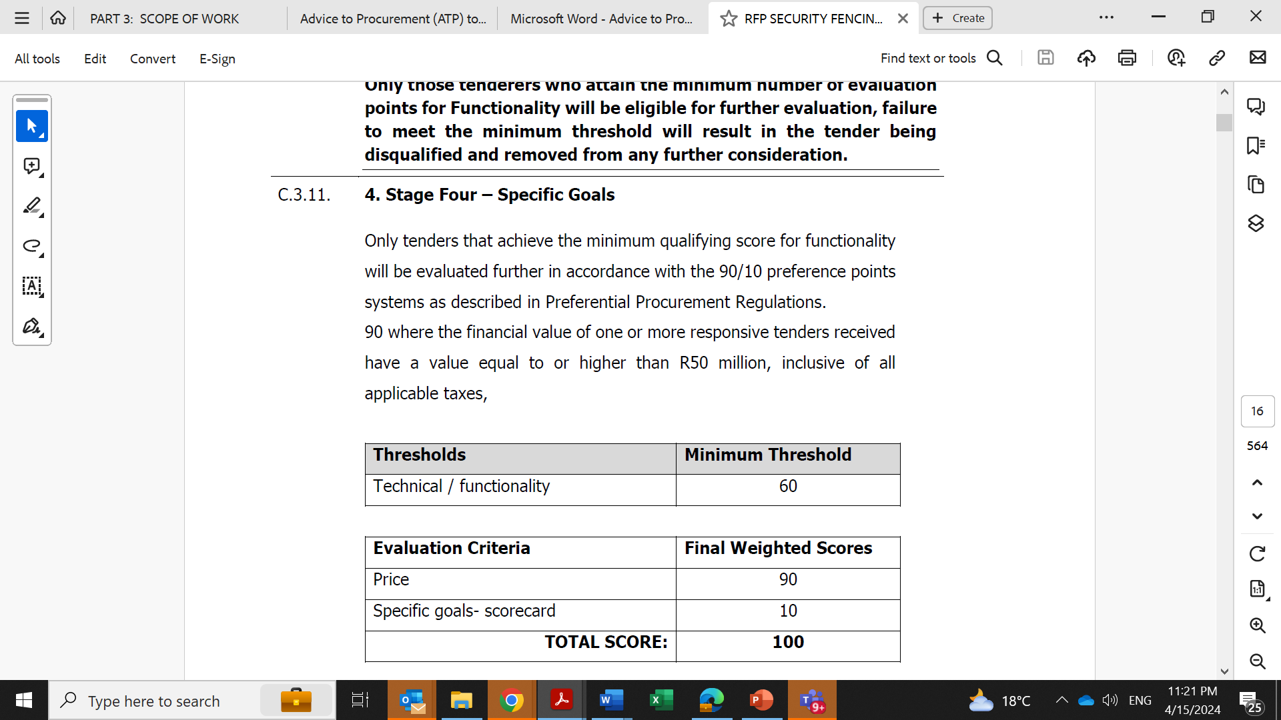
STAGE 3: PREFERENCE POINTS SYSTEM (90/10)
Page 16 of 564
Up to 10 tender evaluation points will be awarded to tenderers who complete the preferencing schedule and who are found to be eligible for the preference claimed. Should the evidence required for any of the Specific Goals applicable in this tender not be provided, a tenderer will score zero preference points for that particular “Specific Goal”.

Slide 13
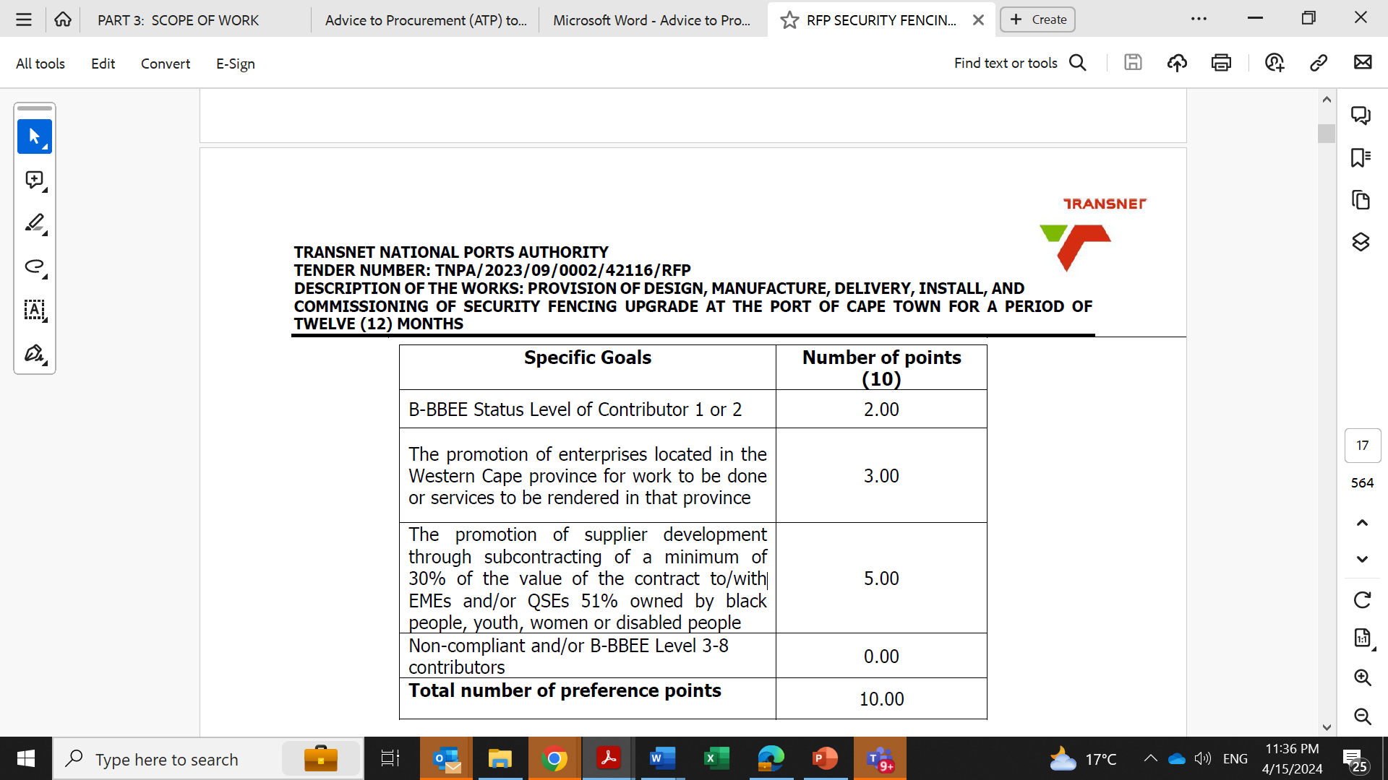
SELECTED SPECIFIC GOALS AND PREFERENCE POINTS
In terms of Transnet Preferential Procurement Policy (TPPP) and Procurement Manuals, the following preference points must be awarded to a bidder who provides the relevant required evidence for claiming points.
Page 17 of 564

Slide 14
SPECIFIC GOALS AND ACCEPTABLE EVIDENCE REQUIRED
The table below represents the evidence to be submitted for claiming preference points for applicable specific goals in a particular tender:
Specific Goals | Acceptable Evidence
B-BBEE Status Level of Contributor 1 or 2 | B-BBEE Certificate / Sworn - Affidavit / B-BBEE CIPC Certificate (in case of JV, a consolidated scorecard will be accepted) as per DTIC guidelines
The promotion of enterprises located in the Western Cape province for work to be done or services to be rendered in that province | CIPC registration documents B-BBEE Certificate / Sworn - Affidavit / CIPC B-BBEE Certificate as per DTIC guidelines Proof of registered address of the entity (e.g., Municipality or Eskom Letter, Levy Statement, etc.)
The promotion of supplier development through subcontracting of a minimum of 30% of the value of the contract to/with EMEs and/or QSEs 51% owned by black people, youth, women or disabled people | Sub-contracting agreement(s) and declaration Subcontractors CIPC registration documents Subcontractors B-BBEE Certificate / Sworn - Affidavit / CIPC B-BBEE Certificate as per DTIC guidelines Certified copy of ID Documents of the Owners which are 51% owned by black women, youth and disabled people Doctor’s note confirming the disability and/or Employment Equity Act 1(EEA1) form
Page 17 of 564
Should the evidence required for any of the Specific Goals applicable in this tender not be provided, a tenderer will score zero preference points for that particular “Specific Goal”.

Slide 15
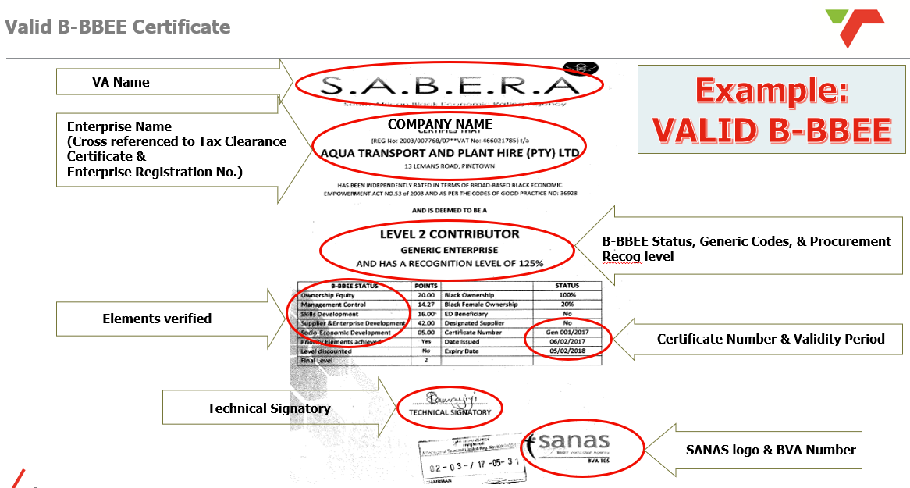
Key Pointers determining the validity of B-BBEE Certificate:

Slide 16
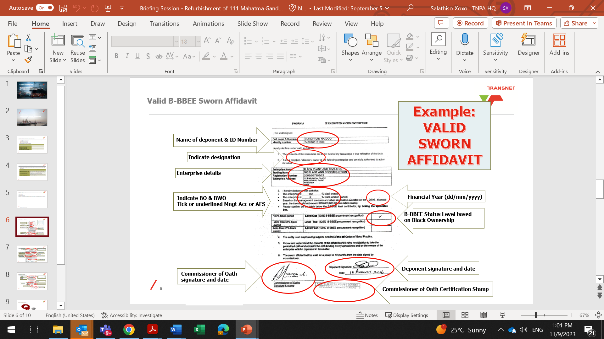
Key Pointers determining the validity of Sworn – Affidavit:

Slide 17
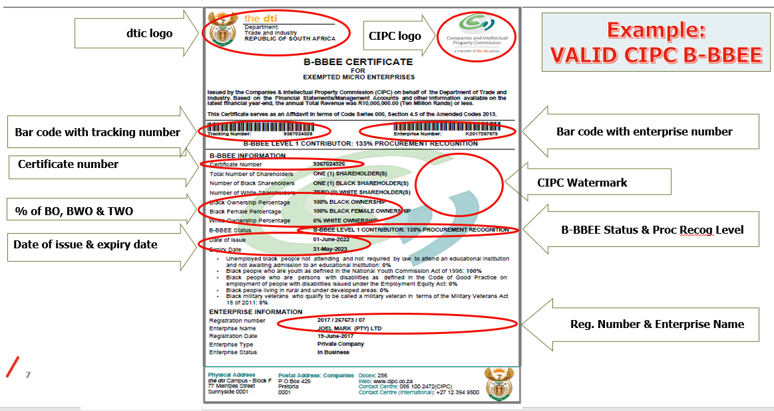
Key Pointers determining the validity of CIPC B-BBEE Certificate:

Slide 18



QUESTIONS & ANSWERS SESSION:

Slide 19
returnable documents
List of Returnable Schedules
General:
T2.2-10: Authority to submit tender
T2.2-11: Record of addenda to tender documents
T2.2-12: Letter of Good Standing for Occupational Injuries and Diseases Act (COIDA)
T2.2-13: Risk Elements
T2.2-14: Availability of equipment and other resources
T2.2-15: Schedule of proposed Subcontractors
T2.2-16: Site Establishment requirements
T2.2-17: Capacity and capability to meet delivery schedule
T2.2-18: CIDB SFU ANNEX G Compulsory Enterprise Questionnaire

Slide 20
returnable documents
List of Returnable Schedules
Agreement and Commitment by Tenderer:
T2.2-19: Non-Disclosure Agreement
T2.2-20: RFP Declaration Form
T2.2-21: RFP – Breach of Law
T2.2-22: Certificate of Acquaintance with Tender Document
T2.2-23: Supplier Integrity Pact
T2.2-24: Supplier Code of Conduct
T2.2-25: Certified copy of signed Joint Venture Agreement (where applicable)
T2.2-26: Disclosure Information: Domestic Prominent Influential Persons (DPIP) OR Foreign
Prominent Public Officials (FPPO)
T2.2-27: Agreement in terms of Protection of Personal Information Act, 4 of 2013 (“POPIA”)
T2.2-28: Supplier Declaration Form

Slide 21
returnable documents
List of Returnable Schedules
Bonds/Guarantees/Financial/Insurance:
T2.2-29: Insurance provided by the Contractor
T2.2-30: Form of Intent to provide a Performance Guarantee
T2.2-31: Forecast Rate of Invoicing
T2.2-32: Three (3) years audited financial statements
2.2 C1.1 Offer portion of Form of Offer & Acceptance
2.3 C1.2 Contract Data
2.4 C1.3 Forms of Securities
2.5 C2.1 Pricing Instructions (Activity Schedule)
2.6 C2.2 Price List
2.7 C3 Scope of Work
2.8 C4 Site Information

Slide 22
7. Pricing Schedule C2.2 Activity Schedule
THE END USER TO PROVIDER THE BACKGROUND

Slide 23
8. TENDER CLOSING
Transnet has implemented a new electronic tender submission system, the e-Tender Submission Portal, in line with the overall Transnet digitalization strategy where suppliers can view advertised tenders, register their information, log their intent to respond to bids and upload their bid proposals/responses on to the system.
RESPONDENTS ARE TO UPLOAD THEIR BID RESPONSE PROPOSALS ONTO THE TRANSNET SYSTEM AGAINST EACH TENDER/RFQ SELECTED.
The Transnet e-Tender Submission Portal can be accessed as follows:
Log on to the Transnet eTenders management platform website (https://www.transnet.net);
Click on “TENDERS”;
Scroll towards the bottom right-hand side of the page;
Click on “register on our new eTender Portal”;
Click on “ADVERTISED TENDERS” to view advertised tenders;
Click on “SIGN IN/REGISTER – for bidder to register their information (must fill in all mandatory information);
Click on “SIGN IN/REGISTER” - to sign in if already registered;
Toggle (click to switch) the “Log an Intent” button to submit a bid;
Submit bid documents by uploading them into the system against each tender selected.
https://transnetetenders.azurewebsites.net/Home/AdvertisedTenders

Slide 24
8. TENDER CLOSING
Note to the bidders:
Bidders are required to ensure that electronic bid submissions are done hours before the closing date to prevent issues which they may encounter due to their internet speed, bandwidth or the size of the number of uploads they are submitting. Please do not wait for the last hour to submit. A Bidder can upload 30mb per upload and multiple uploads are permitted.
Tender Closing Time and Date : 16h00 on 06 May 2024
RFP deadline for questions / RFP Clarifications: 16h00, 28 April 2024
-
Tender validity period –12 Weeks from closing date
All returnable documents to be signed, completed and returned

Slide 25
Q & A
Q & A

